Slide 1

Logiciel de gestion de version centralisée

Slide 2
INFO
Low-Level Operations
Linus Torvalds for Linux kernel Development
Managing Content of the working tree
Index Files
Complete revision control system

Slide 3
USED BY
Companies (Development & Team projects)
Laboratories (us)
Web-based collaboration and document management softwares
All computer science team projects

Slide 4
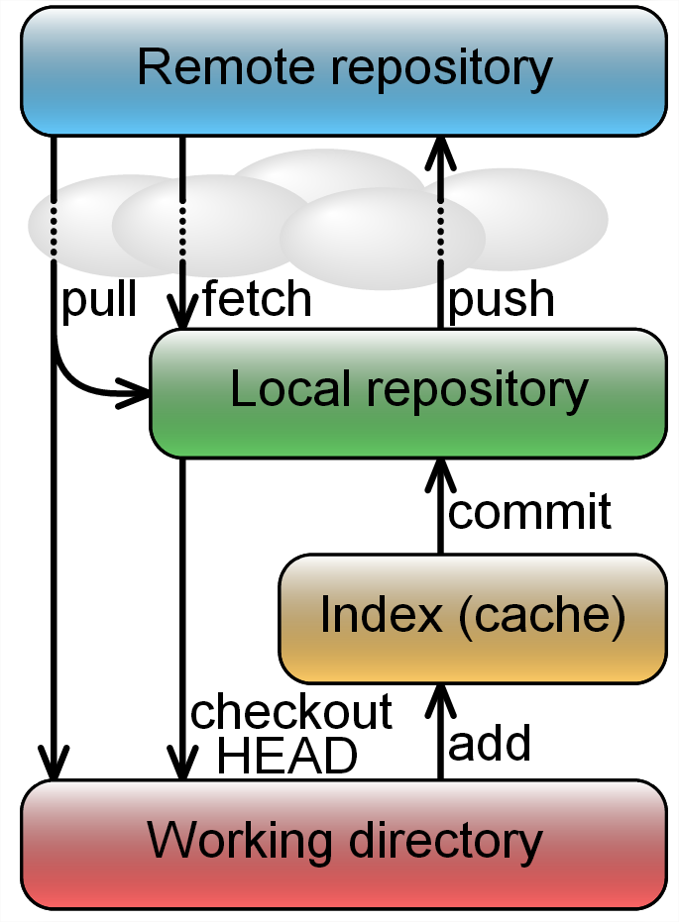
HOW IT WORKS ?
Add
Create a file version (Index) in Blob
Commit + Tag
Send Working directory Index to Local Repository
Push
Send Local repository Index to Remote Repository
Pull
Download Remote repository Index and erase the other
ones in Working directory.
Diff

Slide 5



HOW CAN I USE IT ?
TortoiseGit
Revision control client
implemented as a Microsoft Shell Extension
Free (GNU Public Licence)
Git Extensions
Git HUB

Slide 6
HOW WILL WE USE IT ?
Github Remote Repository
TortoiseGit Revision Control C.
Some Files / Code ... :D

Slide 7






OTHER TOOLS
CVS
Subversion (SVN)
IBM Rational ClearCase
Perforce

Slide 8
Think You For Listening
?
By FUKAKAI

